Slide 1
Branding Flexible Registration with Customizations
Brandman University
Presented by: Caroline Gottschling & Stacey Tune
April 08, 2014
Session ID 3067
Notes:
Introduction
Question – F or T
Function users vs technical users:
Functional Users:
Allay fears of prior knowledge
Self taught as a functional team member – not a trained graphic designer or web developer
Learned on the spot
Vocabulary you need to know to either do it yourself or disseminate your vision to a webmaster
Stress the importance of relationship needed between WM and DBA
Technical majority –
Will walk through some technical pieces but will also show ways to put technical information into layman's terms to communicate more effectively with functional teams if they are the ones who are going to be making the customizations (and vice versa)

Slide 2
Session Rules of Etiquette
Please turn off your cell phone/pager
If you must leave the session early, please do so as discreetly as possible
Please avoid side conversation during the session
Thank you for your cooperation!

Slide 3
Introduction
Welcome! After attending this session, you will:
Understand branding possibilities within the application
Recognize how customizing the CSS can enhance the look of catalogs
Know how to customize the text, color scheme, images and homepage content, and
Know how to upload customized files to the server

Slide 4
Agenda Slide
Topics:
History of Brandman University
Branding possibilities
Introduction to the CSS language
Walk through customizations

Slide 5
About Brandman University
Why we utilized the Flexible Registration application as another marketing vehicle
Notes:
Discuss history of BU and the reasoning behind our customizations

Slide 6
About Brandman University
1861 - Chapman University
1958 – Chapman University College
2010 – Brandman University
Target markets & WASC considerations
Brand awareness marketing campaign
Notes:
1861 – CU was est. as a small, private liberal arts university in Southern CA
Serves the traditional 18-24 year olds
1958 – CUC was est. as part of the CU systems
Meet the needs of military personnel transitioning back into civilian life
Because of this population, our students were typically older than the traditional CU student
For over 50 years, our audiences were so different, WASC suggested CUC separate from CU
In 2010, CUC became BU
Because of the name change, brand awareness has been our major marketing initiative
Students highly identified with the CU name
We were in a place where we had 50 years of history but were essentially a start-up
So to begin getting students to identify with the new brand, it was crucial for us to keep all web platforms consistently displaying the brand name

Slide 7
Branding Possibilities
How to use Ellucian’s Flexible Registration application for marketing
7
Notes:
In a quest to create consistency across all platforms, we decided to explore the possibilities with Ellucian’s Flexible Registration site
In the next couple of slides, I am going to show you the consistency that we feel we have created and point out what is customizable in this application

Slide 8
Branding Possibilities
What is customizable in the application?
Header Logo
Content (Text)
Catalog Homepage Content Areas
Color Scheme
Icons
Notes:
These are the pieces I learned to be customizable in Ellucian’s Flexible registration site
I am now going to show you the output of our university’s customizations
Discuss the _Shared folder here

Slide 9
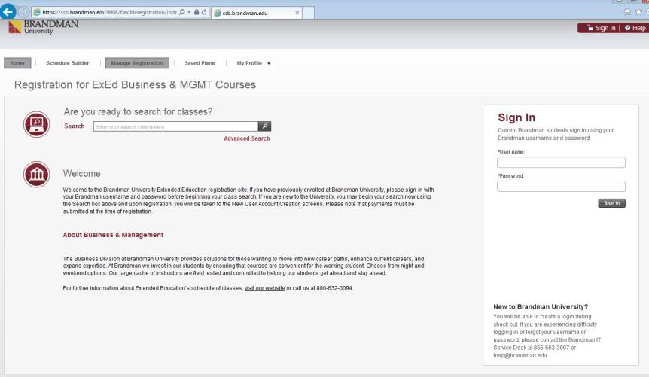
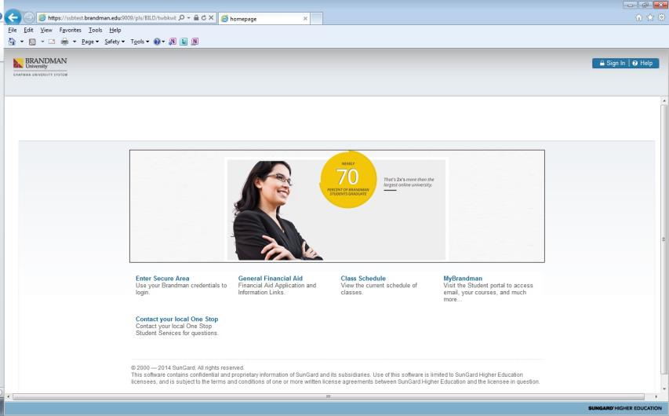
Branding Possibilities
Notes:
This is our externally facing website
Primary colors shown are gold, maroon, gray
Part of our customization strategy was to bring these colors into the Banner applications
Here is our customized Banner Self-Service homepage
We customized images including the background header image and the main block image with our brand colors and student profiles
Students access this site through our website or similarly branded student portal
Here is one of our customized flexible registration catalogs
Following similar patterns, we utilized our university’s style guide to bring in our brand image into the application
Similar to Banner Self Service, this application is accessed from our website and/or with the direct URL
When students click on the registration link from our ExEd program pages, they land in one of our many catalolgs
We didn’t want students to feel they were being sent all over cyber space…so that was our major goal in making these customizations
To get this look, we customized the logo, content, catalog homepage content, color scheme and icons/images
All of the customizations made required access to the _shared folder (resource directory)
This is where all files that the Flex Reg application downloads reside
This is the folder you will externalize to replace baseline banner files with your customized files
Stacey will go more in-depth on this later on in the presentation
LOGO
Image file in the assets subfolder of the resource directory
Baseline downloads the sungard university logo
Please keep the dimensions of the logo the same 212px x 32px
Necessary change prior to going live
CONTENT (TEXT)
Properties file in the locale subfolder of the resource directory
Baseline banner downloads sungard university references
You can take this further and customize the content to meet your institutions language
CEU/PDU, Invoice, Registration Disclosure
Necessary change
CATALOG HOMEPAGE CONTENT
Html file in content subfolder of resource directory
Marketing tool
Targeted messaging
Have specific html files for each of our catalogs
Seen across other university catalogs one file that houses general reg info, payment instructions, contact info, etc
Either solution is ok…just do what meets the needs of your institution
Over the past year….realized our permalinks skip this. Might move to one file
Necessary Change
The next two customizations are taking it beyond the min. requirement. We found the following to be the most visually impactful. The two elements are:
Color scheme
Icons and Images
COLOR SCHEME
CSS file in the styles subfolder of the resource directory
Requires going through the entire application, identifying where each css element lives and changing the CSS file with brand/desired colors
Rorry’s trick (CSS inspector alert box) – displays css style information for a given component
SHIFT and Left Mouse
ICONS/IMAGES
JPEG files in the assets subfolder of the resource directory
Took each icon/image we wanted to customize, into Photoshop, and used layers to display our colors
Most Impact - background header image
Not in the CSS
Repeating image that spans the width of the application
Never change
Name of file
Type of file
Dimensions of images
The browser/app will download only the file names it is setup to load.
Will look to your institutions externalized resource directory (Customized Files) first and if there is something there it will load it. If not, it will load baseline files

Slide 10
Introduction to the CSS Language
10
Notes:
Now that we have seen an overview of what is customizable, Stacey is going to walk us through a functional and technical introduction to the CSS language

Slide 11
CSS Language
What is the CSS language?
CSS & HTML
How browsers apply style
Formatting text
Color scheme customizations
Notes:
Logo size issue

Slide 12
A Walk Through Making the Customizations
12
Notes:
Show how customizations are made
Cannot access test environment outside of our firewall, so I made 3 videos so you can see the changes in real time
Time constraints
Might not get through all
We will provide you with a link to a document resource page on our website. There you will find
All three videos to watch at your convenience
Organization spreadsheets
This slideshow
etc

Slide 13
Customizations
Before you get started…
Read the customization guides
Gain access to the resources folder
Download the Brandman University string.properties spreadsheet
Install necessary software applications
Notes:
Time and Skill
One week – universal changes
Reoccurring changes varies (homepage content, updates)
Majority of time spent on
Learning each of the screens and where elements are
Organizing the edits
Skills
Limited knowledge prior
Can easily be taught/learned
Work with IT or marketing
Use the guides
Great resources
Tips and tricks
Read them before you begin
Spreadsheet
Track properties changes – in case you need to go back
Key value

Slide 14
Customizations: Homepage Content
Notes:
Video for the different customizations:
Homepage content
Using DreamWeaver
Uploading file to the server – Stacey
Changing “Invoice” to read “Payment History”
Wordpad
Uploading new file to the server – Stacey
Uploading images & icons
Changing the color scheme (line, schedule view, etc)

Slide 15
Customizations: Color Scheme

Slide 16
Customizations: Images

Slide 17
Summary
Resources
Assets, content, images, locale, styles and navigation
Next steps involve someone in your Information Technology department

Slide 18
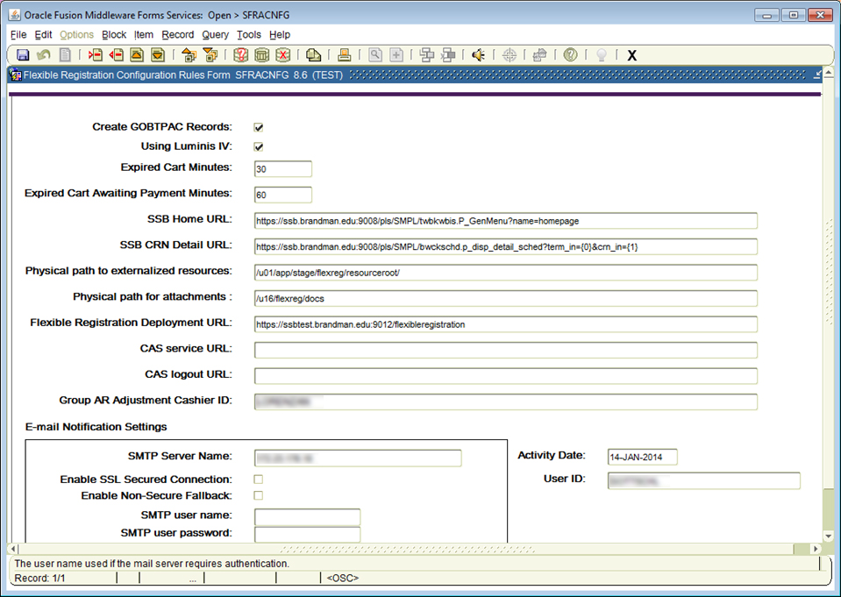
Upload Process
Get external file system path
Load files from specified folder
No File
Files present
Return loaded files
Load files from Application server
Notes:
Here is were all of your communication must occur between our functional and technical teams, unless the technical team is in charge of making all of the customizations & loading them externally
_Shared Folder:
Get a copy of the _shared folder from your DBA or consultant to externalize the resources
This folder will drive the look and feel of your site
Define the physical path to the %resourceroot% folder in SFRACNFG
All baseline files will eventually be wiped out of this folder and will only contain those files that are customized
Before wiping the folder, make two copies of the folder and save it to your machine
Use one copy of the folder as a file name reference (trust me!)
Use the other copy as the working folder that will then be loaded onto your university’s server or wherever you are housing your externalized resources
Clear out all files in the working folder.
From your reference folder, choose the file you wish you customize and open in the appropriate application.
For example, in the videos that will follow, I will open up the default catalog homepage_A0.html file, the baseline CSS file, and the baseline strings.properties file.
I will make any intended changes and save the files in the working folder using the exact files names baseline Banner assigns.
Once all of the customizations have been made, I will then send the _shared folder to our IT Webmaster to load into the externalized resourceroot directory (server)

Slide 19
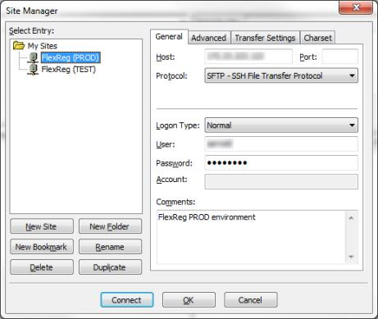
Upload Process
Access to folder
File Transfer Protocol (FTP) application
filezilla-project.org
Open source software distributed free of charge

Slide 20
Upload Process

Slide 21
Questions & Answers

Slide 22
Thank You!
Caroline Gottschling | Stacey Tune
gottschl@brandman.edu | sarnold@brandman.edu
http://services.brandman.edu/banner/default.html
Please complete the online session evaluation form
Session ID 3067
.
© 2014 Ellucian. All rights reserved.

